Slide 1
PostgreSQL

Slide 2

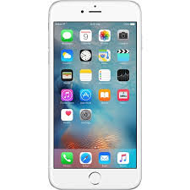
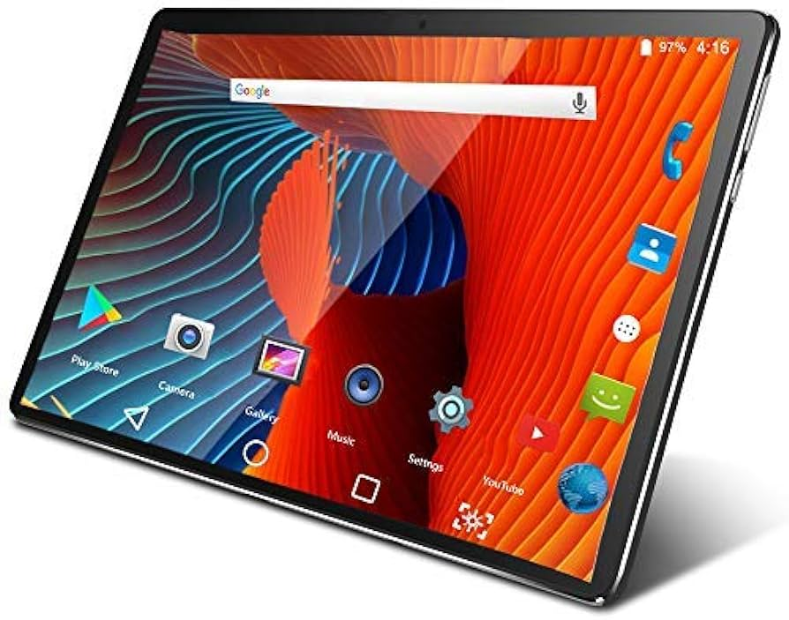
Database

Slide 3
Database
User
Ismi | Familiyasi | Paroli | Username | Email | Phone
Hasan | Hamidov | asihqeaydas | Hasan_hamidov | hasan@gmail.com | +998 90 123 45 67
Husan | Hamidov | qi3egqwveqw | Husan_off | husan@gmail.com | +998 88 101 10 11
Ravshan | Sodiqov | Hggyasyd sdsa | iRavshan | ravshan@mail.ru | +998 90 443 90 23

Slide 4
SQL:
Structured Query Language
PostgreSQL:
RDBMS
RDBMS:
Relational Database Management System
Relatsion ma’lumotlar bazasini boshqarish tizimi

